Slide 1

CSS
Lesson 8

Slide 2
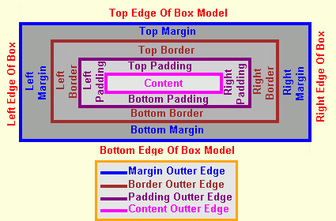
CSS Margin
The margin clears an area around an element (outside the border). The margin does not have a background color, and is completely transparent.

Slide 3
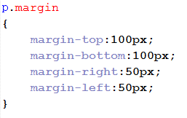
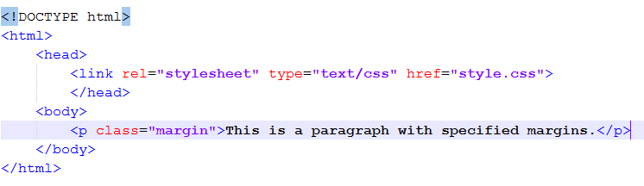
CSS Margin
style.css
doc.html

Slide 4
CSS Margin
The shorthand property
margin:25px 50px 75px 100px;
  top margin is 25px
  right margin is 50px
  bottom margin is 75px
  left margin is 100px
margin:25px 50px 75px;
  top margin is 25px
  right and left margins are 50px
  bottom margin is 75px
margin:25px 50px;
  top and bottom margins are 25px
  right and left margins are 50px
margin:25px;
  all four margins are 25px

Slide 5

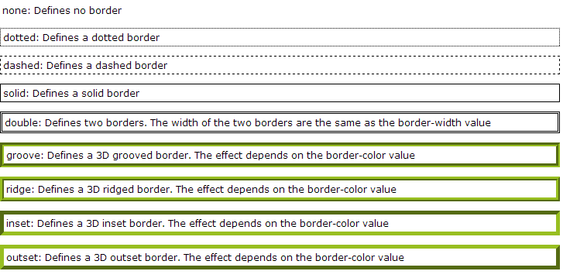
CSS Border
Border-style property

Slide 6
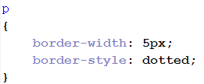

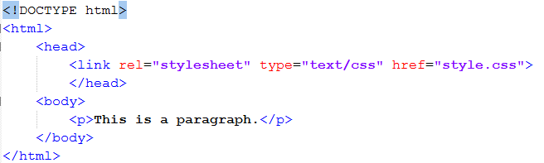
CSS Border
Border-width, Border-color property
style.css
border-width :thin, medium, thick
doc.html

Slide 7
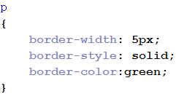

CSS Border
Border-color
style.css
doc.html

Slide 8
CSS Border
Border - Individual sides
Property | Description
border | Sets all the border properties in one declaration
border-bottom | Sets all the bottom border properties in one declaration
border-bottom-color | Sets the color of the bottom border
border-bottom-style | Sets the style of the bottom border
border-bottom-width | Sets the width of the bottom border
border-color | Sets the color of the four borders
border-left | Sets all the left border properties in one declaration
border-left-color | Sets the color of the left border
border-left-style | Sets the style of the left border
border-left-width | Sets the width of the left border
border-right | Sets all the right border properties in one declaration
border-right-color | Sets the color of the right border
border-right-style | Sets the style of the right border
border-right-width | Sets the width of the right border
border-style | Sets the style of the four borders
border-top | Sets all the top border properties in one declaration
border-top-color | Sets the color of the top border
border-top-style | Sets the style of the top border
border-top-width | Sets the width of the top border
border-width | Sets the width of the four borders

Slide 9
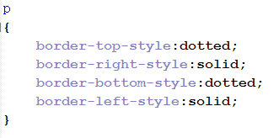
CSS Border
Border - Individual sides
style.css
doc.html

Slide 10
CSS Border
The shorthand property
border-style:dotted solid double dashed;
  top border is dotted
  right border is solid
  bottom border is double
  left border is dashed
border-style:dotted solid double;
  top border is dotted
  right and left borders are solid
  bottom border is double
border-style:dotted solid;
  top and bottom borders are dotted
  right and left borders are solid
border-style:dotted;
  all four borders are dotted
border-width
border-style (required)
border-color
border:5px solid red;

Slide 11
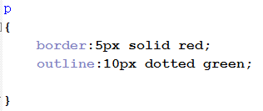

CSS Outline
style.css
doc.html

Slide 12

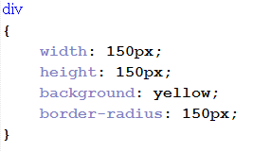

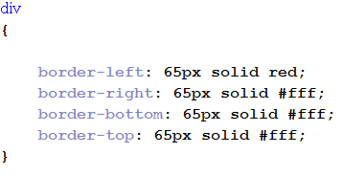
Some tricks

Slide 13
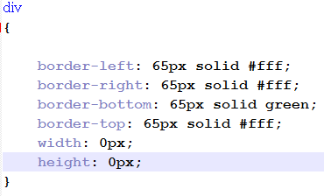

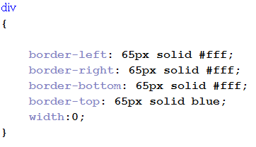

Some tricks

Slide 14
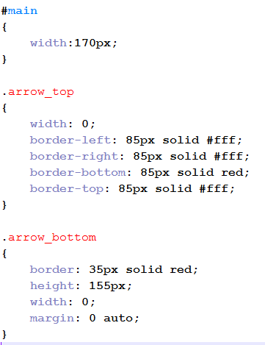


Some tricks

Slide 15

Task1:

